Slide 1

Expense Manager
Project Presentation
By
Nithin George
22PMC140

Slide 2

Abstract
Managing personal expenses can be challenging in today's complex world. To address this, I introduce an easy-to-use Expense Manager application. This application helps users track and control their expenses effectively. This Expense Manager simplifies expense management with intuitive features. Users can effortlessly record expenses and monitor their financial health in real-time. Expenses are categorized based on personal requirements, giving users insights into spending patterns and areas for improvement.
The Expense Manager provides visualizations and reports, summarizing financial data for easy analysis. In summary, our Expense Manager application is a user-friendly tool that simplifies personal expense management. With budgeting features, and clear analytics, users can take control of their finances, achieve their goals, and improve their financial well-being.

Slide 3

Project Requirements
1. Record and categorize expenses: provides users to add, edit and delete expenses and incomes based on category
2. Budget Tracking: Option to view budgets spend for different categories.
3. Calendar view: Calendar based daily expenses and incomes view.
4. Export options of the expense: Expenses can be exported to various export options to CSV, Excel, Pdf etc.
5. Export options of the income: Incomes can be exported to various export options to CSV, Excel, Pdf etc.
6. Profile management : manage your profile.
7. Mobile view: Responsive design to fit into your mobile screen.
8. Admin dashboard: Customized Django Admin site from the traditional one.
9. Set a custom Currency: You could set a custom currency according to your preference.

Slide 4

Features and Highlights
Ability to add, edit, and view expenses with categorization options
Users can view income and expenses as graphs for different categories
A Customized Calendar view that gives the summary of income and expense of each day.
Users can export the data of expenses and incomes whenever required.
Project is designed in such a responsive manner that users you use this web app in their mobile phones as well.

Slide 5

Architecture of the project
The architecture of the Expense Manager project follows a layered and modular design, incorporating key components and their interactions to provide an efficient expense management system.
Presentation Layer:
User Interface: It handles the user interaction and provides a user-friendly interface for accessing the application.
Views and Forms: It comprises the screens and forms that allow users to input expenses, set budgets, and view reports.
Application Layer:
ExpenseMain Module: It acts as the core functionality of the system, handling expense recording, categorization, and budget visualisations.
ExpenseManager: It handles the main urls that manages the application

Slide 6
Architecture of the project
3. Data Layer:
Database: It includes a relational database management system called sqlite to store user data, expense records, budgets, and other relevant information.
Object-Relational Mapping (ORM): An ORM tool is used to map database entities to application objects, facilitating data retrieval and manipulation.
4. Integration Layer:
External APIs: This component integrates with external systems, such as FullCalendar APIs or Chart Js APIs, to visualize the transaction data automatically.
5. Reporting and Analytics:
Reporting Engine: This component generates reports and visualizations based on user preferences and selected data parameters.

Slide 7
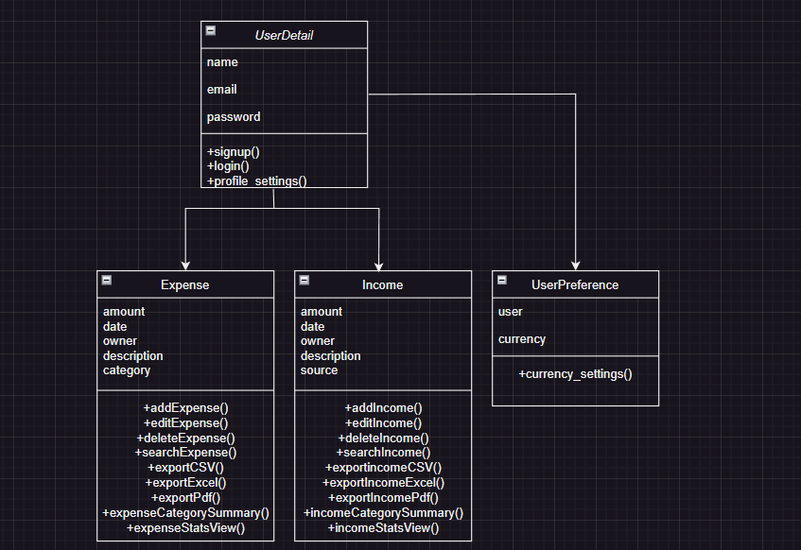
Class Diagram of the project

Slide 8







Third Party libraries & API’s
Django-jazzmin : It is used at the admin page to provide a responsive design.
CSS-Bootstrap 5 : It is used to create a consistent and professional looking user interface.
PDF Generation – ReportLab : It is used to generate PDF documents programmatically.
Visualisation- ChartJs : It is used for creating interactive and visually appealing charts and graphs.
CSV: It is used to export data as CSV.
XLWT: It is used to export data as Excel.
FullCalendarJs : It is used to display calendar to render events.

Slide 9


Challenges faced during development
My major concern was implementing the calendar view to the project such that the total income and expense summary is returned for each day. I had to figure out a way to bring the data from database to the FullCalendar API. Even though I had previous experience of implementing FullCalendar on my project while I was working, I had to brush up all the concepts again. After quite some research, I finally managed to pass data from the database as Json format and then render them as events on the Calendar. I had to make use of ChatGPT and the official documentation of FullCalendar Js.
Secondly, I was new to implementing ChartJs and after hours of research at ChatGPT and the official documentation of ChartJs, I finally managed to show output of incomes and expenses based on category as charts.

Slide 10
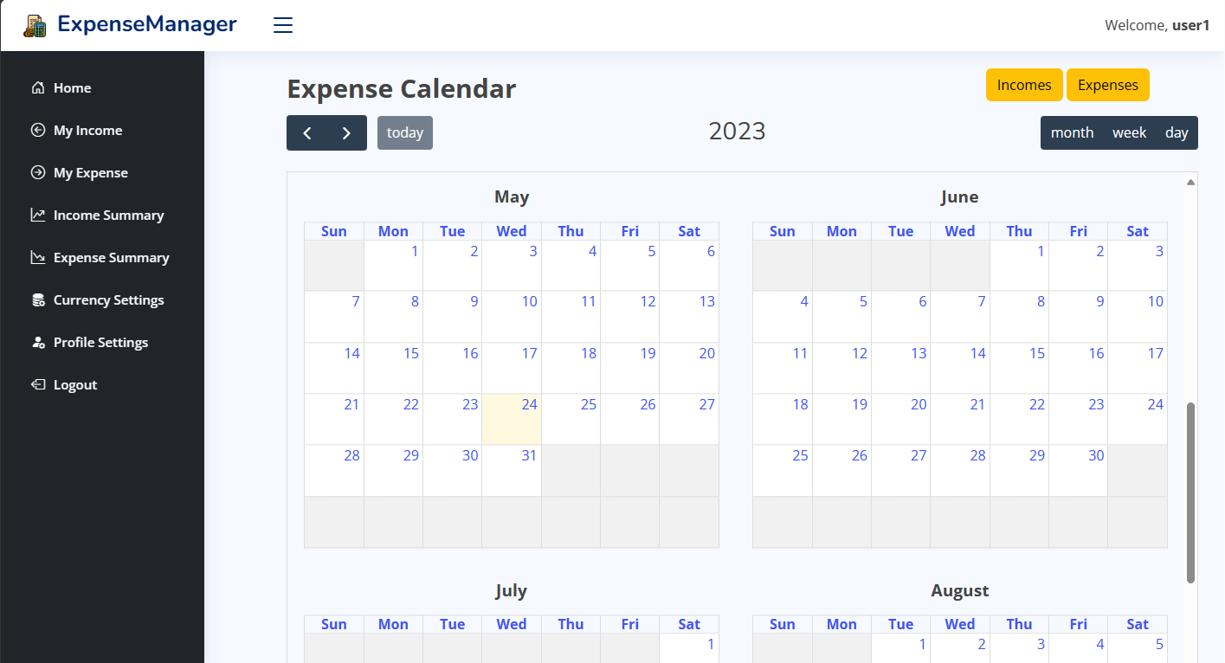
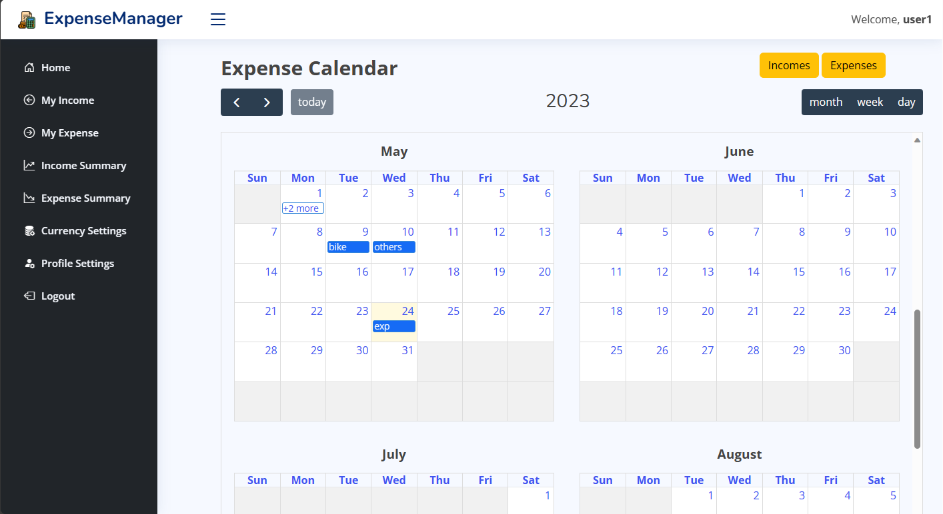
Screenshots
This is the home page which displays a calendar and two buttons marked with the red rectangles which shows the income and expenses of each month as a summary in two separate calendars. The second screenshot is an example of how the expenses are displayed as summary. Likewise, we can see the summary of income as well. Moreover, we can change the view of calendar to month, day and week format.

Slide 11
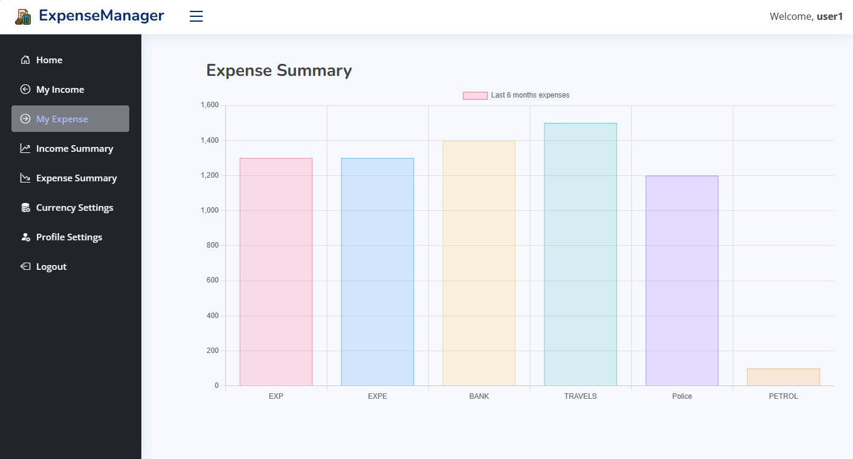
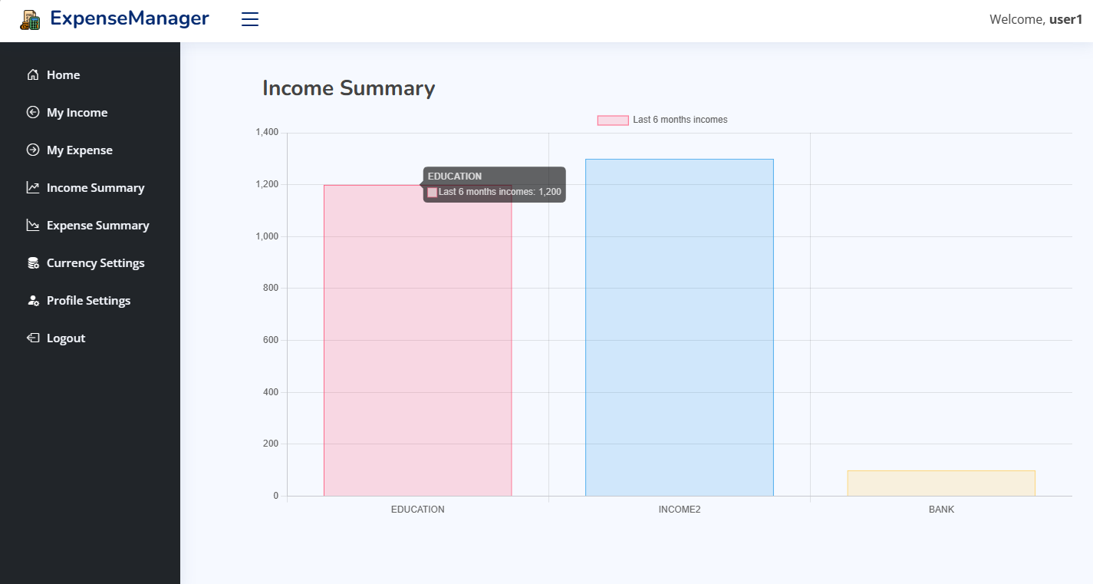
Screenshots
The two screenshots shows the Expense and Income Summary as bar charts respectively which are distinguished on the basis of categories that the user has entered. The charts are displayed on the basis of last 6 months expenses and incomes respectively.

Slide 12
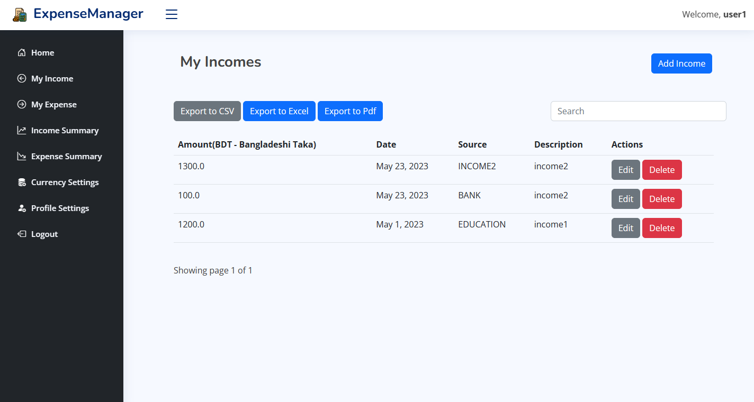
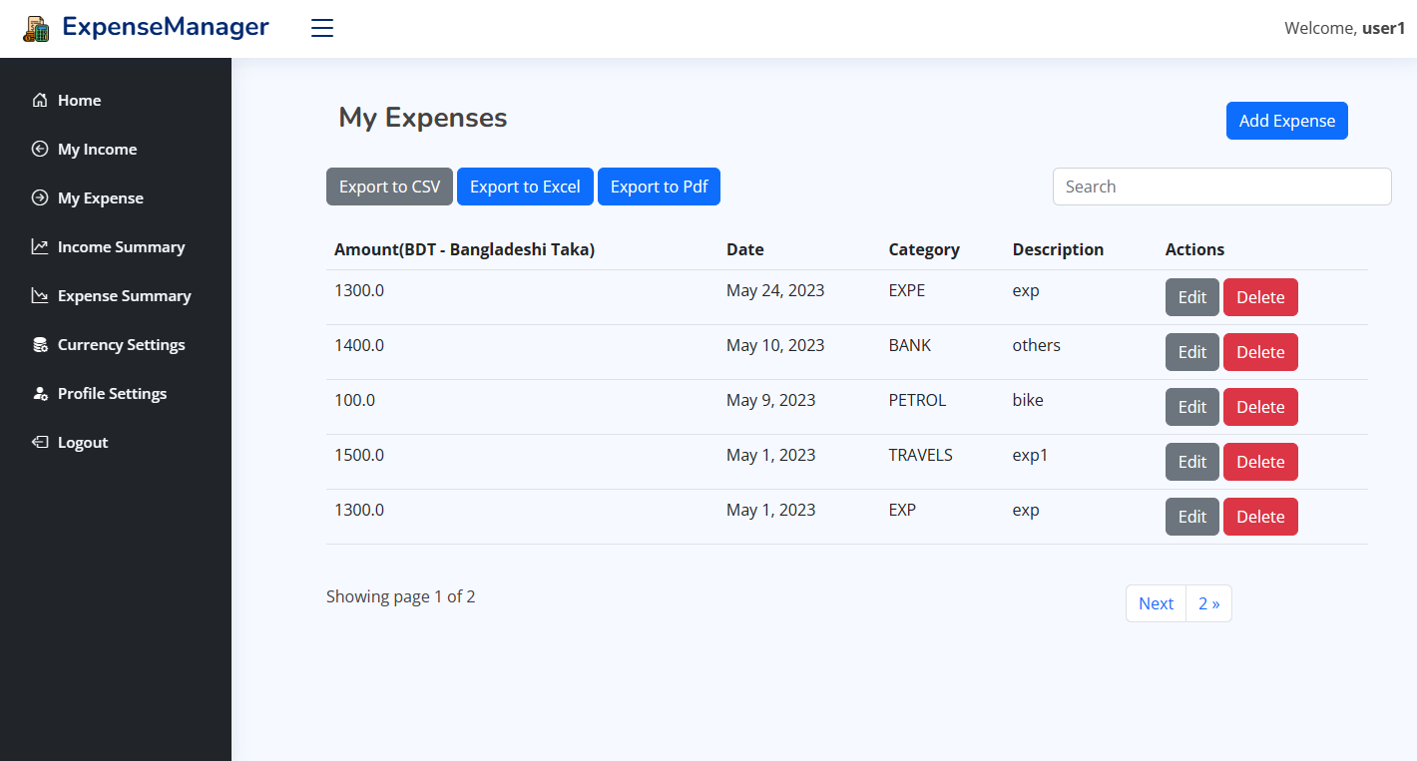
Screenshots
The two screenshots shows the Income and Expenses entered by the user such that the following page lets users add, edit and delete incomes and expenses. Moreover, User could export the data as CSV, Excel or to Pdf formats as per their requirements.

Slide 13

Future Enhancements
As Future Enhancements, I would like to add feature like:
Live Budget alerts
Live income and expense insertion after transactions
Ability to customize the income and expense summaries shown as graph on the basis of dates.
Live Currency conversion rates and the ability to customize the incomes and expenses on the basis of these conversion rates.
Expense and Income import feature from excel
Smart budget recommendation from analysis on previous transactions

Slide 14
Conclusion
In conclusion, the Expense Management application is a powerful tool that simplifies and enhances personal expense management. With its user-friendly interface and robust features, users can effortlessly track, categorize, and control their expenses, leading to better financial health and improved financial well-being.
Through insightful visualizations and reports, the application provides users with clear and concise summaries of their financial data. These analytics enable users to identify spending patterns, recognize areas for improvement, and make informed financial decisions.
Overall, the Expense Management application is a valuable tool for individuals seeking to gain control over their finances, achieve their financial goals, and improve their overall financial well-being. By simplifying expense management and providing useful features, the application empowers users to make smarter financial choices and navigate their financial journey with confidence.

Slide 15

References
Live Project Demo: https://nithingeorge2000.pythonanywhere.com/
ChatGPT
FullCalendar Js
Chart Js
Django documentation

Slide 16

Thanks!
Nithin George
georgenithin180@gmail.com
+91 9497304051

